Slide 1
Unit 2 Out of this world
Integrated skills (I)
翟媛媛 南京市第二十九中学

Slide 2
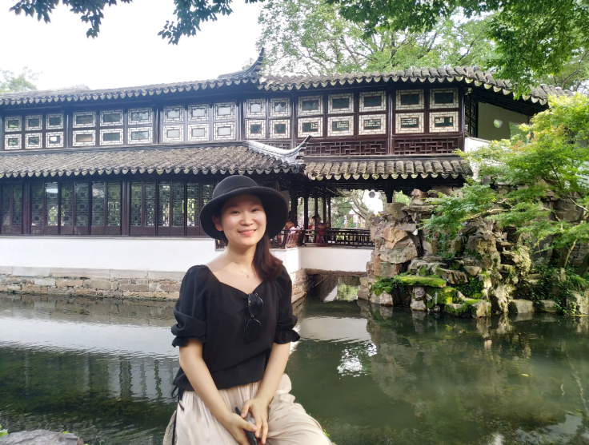
翟媛媛
南京市骨干教师
全国高中英语基本功大赛展评课一等奖
省高中英语优质课大赛二等奖
市高中英语优质课特等奖
所带班级南京市先进班集体
省级期刊发表专业论文多篇

Slide 3
1) What can we say about the woman?
A. She’s generous.
B. She’s curious.
C. She’s helpful.

M: Hello, do you have “The Best of Mozart”?
W: Um... sorry, we’ve just sold out. But we can order one for you. If you give us your number, we’ll call you when the CD arrives.

Slide 4
2) How does the woman feel about James’ situation?
A. Embarrassed. B. Concerned. C. Disappointed.

W: Did you know James went out of business?
M: Really? When was that?
W: Last month.
M: That’s too bad! He had owned that business for 15 years. What happened?
W: I don’t know. But life must be pretty tough for his family now. His sons are still so young. One is 13 and the other is 10.
M: Well, maybe things are not as bad as they seem to be.
W: I hope so.

Slide 5
Listening tips
When listening sometimes you may need to know the speakers’ attitudes. You should try to listen for some words or phrases that have a positive or negative meaning, e.g. good, great, fantastic, I like/enjoy, bad/terrible/awful, I don’t like/dislike.

Slide 6
Guess what to listen
There must be two speakers talking about aliens from a film.
They may be talking about their likes and dislikes of the film.
Perhaps they are also talking about the humans involved with aliens…

Slide 7
Listen for true-false tests A1
1. T
2 T
3. F (Jenny → Bob, Bob → Jenny)
4. T
5. F (destroy → save)
6 F (boring → exciting)

Slide 8
The Beasts from Mars
 The aliens are really frightening.
 They look like huge ⁽¹⁾________________.
 ⁽²⁾________________ bring them to the Earth.
 The aliens just want to ⁽³⁾________________. They breathe on something until it is a ball of fire.
fire-breathing bears
Those scientists
destroy everything

Slide 9
Strangers from space
 The alien look like big jelly fish.
 They are much more ⁽⁴⁾________________ than us.
 People from all over the world work together to ⁽⁵⁾________________ and find out their message.
 With the help of the aliens, we manage to ⁽⁶⁾ ________________ another group of aliens.
intelligent
translate their language
fight off

Slide 10
Jenny: Hey Bob, have you seen the sci-fi film that everyone’s been talking about?
Bob: Yeah, it’s great! The Beasts from Mars!
Jenny: I just saw it last night. It is enjoyable except that those aliens are really frightening. They aren’t like us at all! They are more like huge fire-breathing bears!
Bob: I know! They look really strange and they aren’t intelligent at all. I’d hate to meet aliens like that. I don’t know why those scientists bring them to the Earth.
Jenny: Right, they just want to destroy everything, don’t they? When they see something like a car or a house, they just breathe on it until it is a ball of fire.
Bob: Yes, it’s quite scary. Do you think aliens like that really exist on other planets in outer space?
Jenny: Well, I’m not sure about aliens like that, but I guess it’s possible that there’s life on other planets. What do you think?
Bob: I think there must be life somewhere. I hope they are friendlier than the beasts from Mars, though. I’ve read a book called Strangers from Space recently about aliens who come to the Earth to save us. They look like big jellyfish but they are much more intelligent than us.
Jenny: Oh, really? How do we manage to understand them?
Bob: That is what half of the book is about. The aliens don’t speak; they just draw pictures. People from all over the world work together to translate their language and find out their message.
Jenny: I see. So they are warning us of some danger?
Bob: Exactly. Another group of aliens are coming here to take over the Earth. With the help of these strange jellyfish, we manage to fight them off!
Jenny: That sounds exciting. I’ll have to check it out!

Slide 11
BP23 Read a comic strip
Setting
One spring evening in the park next to Paul’s house
Paul, a boy, and Alf, a grey alien
Characters

Slide 12
Plot
BP23 Read a comic strip
Paul hears a noise in the park next to his house and goes to investigate. When he arrives, he sees a silver object land in the park that looks like a spaceship. Suddenly, the door opens and a strange-looking being exits the object. The being is a grey colour and Paul realizes it is an alien. The alien tells Paul that he will take him to a new place. Paul is not afraid because the alien is friendly, so he enters the spaceship. Paul and the alien fly into outer space in the silver spaceship to travel to another planet in the universe.

Slide 13
Homework
1. Watch the micro lesson: Listen for attitudes (Optional)
2. Finish off Listening and speaking A1P65 and A2P65
Answers:

Slide 14
A1
1 The search for extraterrestrial intelligence has been going on for decades.
2 Powerful radio telescopes.
3 In 1960.
4 About eleven light years.
5 The origin and nature of life in the universe and the evolution of intelligence.
A2
1 body language
2 cultural gap
3 a common language
4 maths and science
5 the universe 6 develop advanced technologies

Slide 15
4) These local citizens now have to balance their traditional self-supporting hunting lifestyle with the lifestyle offered by the modern French Republic, which brings with it not only necessary state welfare, but also alcoholism, betrayal and even suicide.
A. The modern French lifestyle.
B. The self-supporting hunting.
C. The uncivilized hunting.
D. The French Republic.


